Slide 1
AI Fitness Trainer
Aminu Abdusalam

Slide 2

Agenda Start 6:00 (CT) End 6:12 (CT)
What (Abstract)
Why (Background)
How & When
Technical Details
Timeline
Demo
Conclusion
References
Q/A
Notes:
This is the agenda of what I plan to go through today:
I’m roughly budgeting 10 mins for each project but feel free to raise your hands as I’d be keeping an eye out for questions, but I did budget time at the end if we run out of questions as I wanna make sure everyone questions is answered.
Thank you!

Slide 3
What
Notes:
Features including proirities

Slide 4
Abstract
The project aims to develop an AI fitness trainer that incorporates storage and recommender systems, as well as an AI virtual mouse.
The trainer will help users achieve their fitness goals, including weight loss and muscle gain, by developing personalized fitness routines, recommending healthy eating plans, and ensuring correct exercise execution.
Notes:
How and when side-by side with explanation of each step shown in details

Slide 5
Why
Notes:
Motivation behind it, impact

Slide 6
Background
The field of computer vision (CV) has seen a surge in interest in recent years, with its applications being leveraged in various industries, from healthcare to self-driving cars.
As technology advances, there is a growing desire to apply CV in everyday activities to improve efficiency and convenience - one area that has been targeted for automation is the process of getting fit.
While traditional activities like bouldering and hiking have been popular methods of staying in shape, they may not always yield the desired results. This has led to the need for an AI Fitness Trainer that can offer customized workout plans, healthy eating recommendations, and accurate exercise monitoring.
This project serves as an opportunity to enhance exposure and learning in the exciting CV field while addressing a pressing need for a product that can improve fitness outcomes.
Essentially, this project presents a win-win situation for both the developers and users, with the former gaining experience in an exciting field and the latter receiving a fantastic product that meets their needs.
Notes:
Computer vision is a field of study focused on enabling machines to interpret, analyze, and understand visual data from the world around them.

Slide 7
How & When
Notes:
Technical Details, timeline, tech stack, farmeworks, tools, APIS, software packages

Slide 8
Features
AI Trainer:
Uses ML algorithms to detect body/pose movements in a video stream (whether live or uploaded).
Utilizes the pose detection together with angles calculation to ensure exercises are performed correctly.
UI Interface:
Offers user-friendly web interface for users to leverage trainer.
Presents users with options including but not limited to recording feature, selection of exercise choice, and selection of level of tracking/confidence of the trainer.
Storage and Recommender System:
Enables user login and authentication.
Generate personalized fitness routine and healthy eating plan based on user data and preferences.
Sends report of activities and related information to user after every session
Stores and keeps track of unique user data
Audio:
Provides audio feedback and instructions during exercises.
AI Virtual Mouse:
Uses hand tracking to allow user control machine WITHOUT touching the machine.
Notes:
How and when side-by side with explanation of each step shown in details
Send report of activities and related information to user after every session (total calories burned, total workout time, etc.)
Store and keep track of unique user data (e.g. target calories, total number of sessions (fitness training days), total calories burned (and per month), number of exercises or days to target calories, etc.)

Slide 9
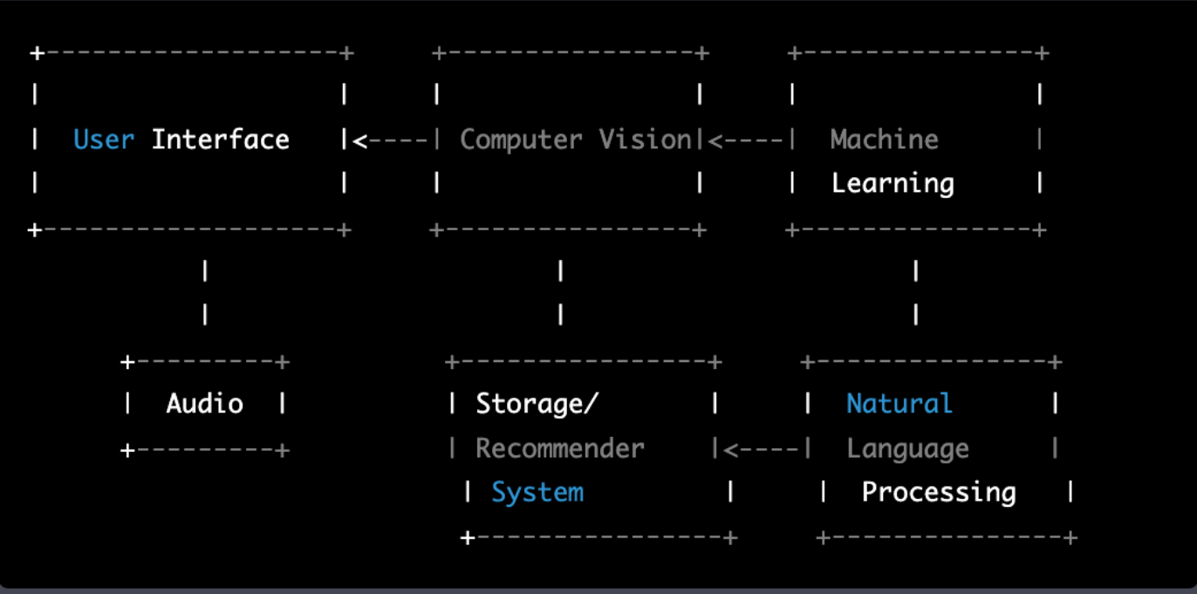
High-Level Architecture
Notes:
This diagram shows that the user interacts with the User Interface, which uses computer vision to detect posture landmarks and calculate angles during exercises. Machine learning algorithms can be used to generate personalized workout plans and healthy eating recommendations based on user data and preferences. User commands and feedback can be processed using natural language processing, while audio can be used to provide audio feedback or instructions during exercises. User information and workout history can be stored and analyzed using a storage and recommender system, which can generate personalized recommendations for workouts and healthy eating plans.

Slide 10
Tools & Technical Details I
Overall, the architecture is built on a combination of computer vision, natural language processing, machine learning, and storage and recommender systems to provide a comprehensive and personalized fitness training experience.
Web App Dev: Streamlit framework was used to develop the User Interface (UI), which includes features like displaying workout routines.
Computer Vision: Utilized OpenCV for capturing and processing images/videos, and the Mediapipe BlazePose model to detect 33 posture landmarks in real-time. These landmarks are used to calculate angles between different parts of the body during exercises.
Machine Learning: Incorporated machine learning algorithms to analyze user data and provide personalized recommendations for workouts and healthy eating plans.
Notes:
How and when side-by side with explanation of each step shown in details
Created PoseDetector Class with the attributes
static_image_mode set to False by default: it will try to detect the most prominent person in the very first images, and upon a successful detection further localizes the pose landmarks. If set to True, person detection runs every input image, ideal for processing a batch of static, possibly unrelated, images.
smooth_landmarks set to True by default: the solution filters pose landmarks across different input images to reduce jitter.
min_detection_confidence for the detection to be considered successful set to 0.5. min_tracking_confidence for the pose landmarks to be considered tracked
successfully, or otherwise person detection will be invoked automatically on the
next input image is set to 0.5.
mp_draw (drawing utilities) and mp_pose (pre-trained pose model) from media pipe solutions.
such as Arm Raise, Curl, Pushup, and Squat, but could be extended to Bicycle Crunch, Bird Dog, Fly, Leg Raise, Overhead Press, and Superman in future.

Slide 11
Tools & Technical Details II
Natural Language Processing (NLP): Employed the Google Text-to-Speech (gTTS) API and speech_recognition library to convert text to speech and recognize user commands.
Storage and Recommender System: Leveraged the smtplib, MIMEMultipart, and MIMEText modules to implement a report-sending feature. Used SQLite to store user information and workout history, and use data analysis and machine learning algorithms to generate personalized workout plans and healthy eating recommendations based on user data and preferences.
Audio: Utilized the playsound module to play audio, which could be used to provide audio feedback or instructions during exercises.
Notes:
How and when side-by side with explanation of each step shown in details
Created PoseDetector Class with the attributes
static_image_mode set to False by default: it will try to detect the most prominent person in the very first images, and upon a successful detection further localizes the pose landmarks. If set to True, person detection runs every input image, ideal for processing a batch of static, possibly unrelated, images.
smooth_landmarks set to True by default: the solution filters pose landmarks across different input images to reduce jitter.
min_detection_confidence for the detection to be considered successful set to 0.5. min_tracking_confidence for the pose landmarks to be considered tracked
successfully, or otherwise person detection will be invoked automatically on the
next input image is set to 0.5.
mp_draw (drawing utilities) and mp_pose (pre-trained pose model) from media pipe solutions.
such as Arm Raise, Curl, Pushup, and Squat, but could be extended to Bicycle Crunch, Bird Dog, Fly, Leg Raise, Overhead Press, and Superman in future.

Slide 12
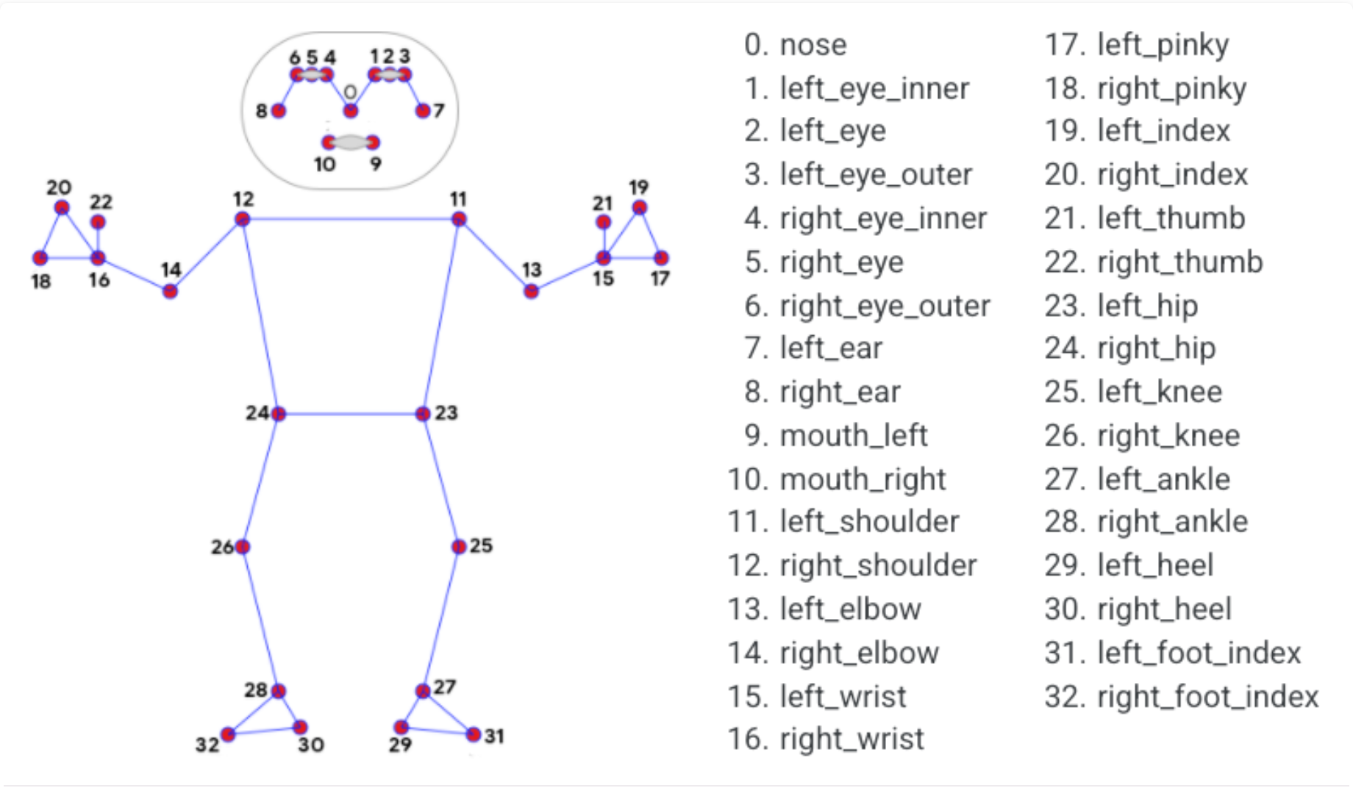
Tools & Technical Details (Image)
Notes:
How and when side-by side with explanation of each step shown in details

Slide 13
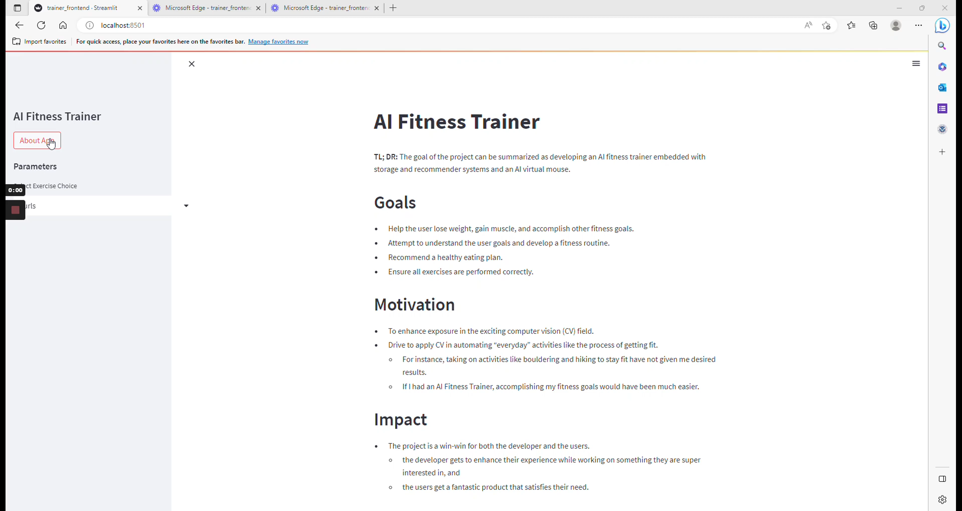
Demo
Notes:
The burned calories is calculated with the formula: [(MET value x 3.5 x body weight in kg) / 200] x time in minutes, where MET value is a measurement of the intensity of the exercise, and body weight is in kilograms.

Slide 14
Conclusion & References

Slide 15
Conclusion
Given the immense potential of exciting technologies and their convergence with healthcare, it is recommended that individuals and organizations explore and invest in the development and application of these technologies in automating everyday activities such as fitness.
This will not only enhance the effectiveness and efficiency of these activities but also contribute to the overall improvement of healthcare outcomes.
It is important to continue to monitor and adopt emerging technologies in this field to stay ahead of the curve and maximize their benefits.

Slide 16
References
Online Courses
Advanced Computer Vision with Python - Full Course
Advance Computer Vision with Python - Computer Vision Zone
StreamLit Computer Vision User Interface Course
Documentations:
Media Pipe: Home | mediapipe (google.github.io)
Open CV: OpenCV: OpenCV modules
Smtplib: smtplib — SMTP protocol client — Python 3.11.2 documentation
Streamlit: Streamlit documentation
Similar Products: 15 Computer Visions Projects You Can Do Right Now - neptune.ai
Study Materials: Pose Classification Options | ML Kit | Google Developers
Sample Trainer Videos: Trainer Videos: Pexels.com
Notes:
Set realistic goals

Slide 17
Q/A
Notes:
Q/A

Slide 18

Thank You!

